Slide 1
ERD Case Study

Slide 2


Slide 3
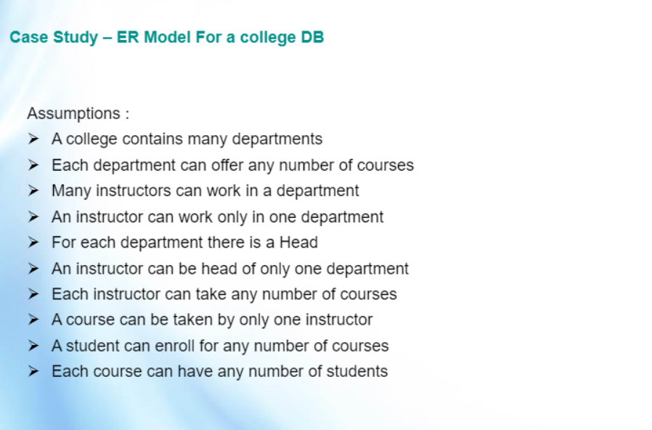

Slide 4
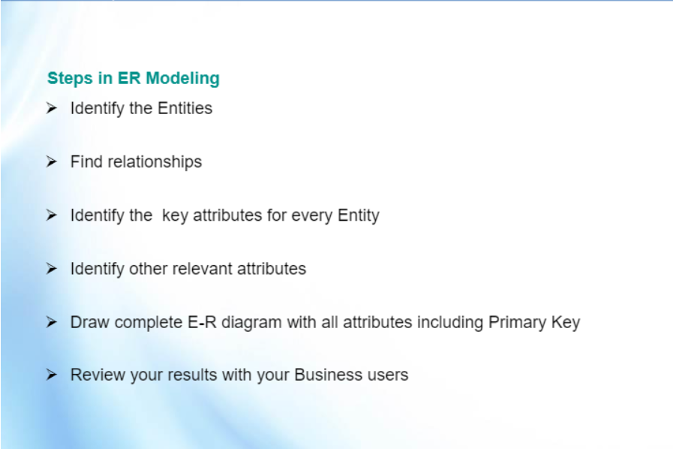

Slide 5
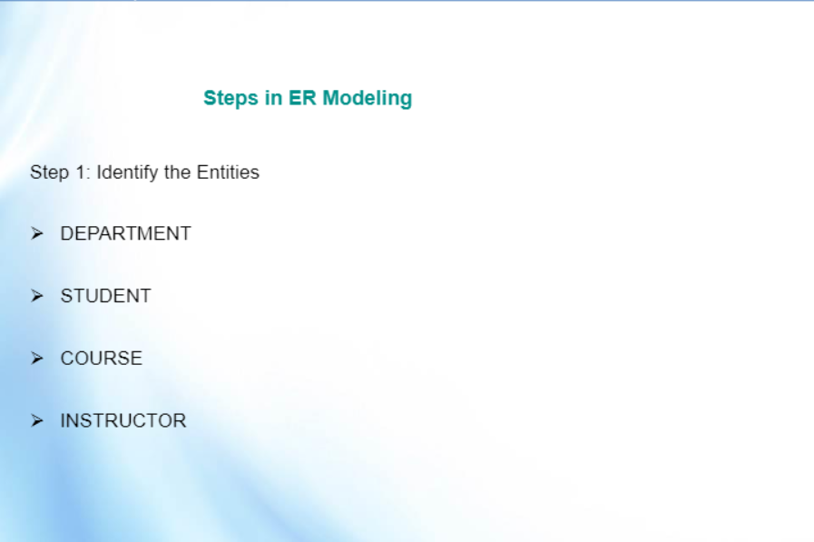

Slide 6
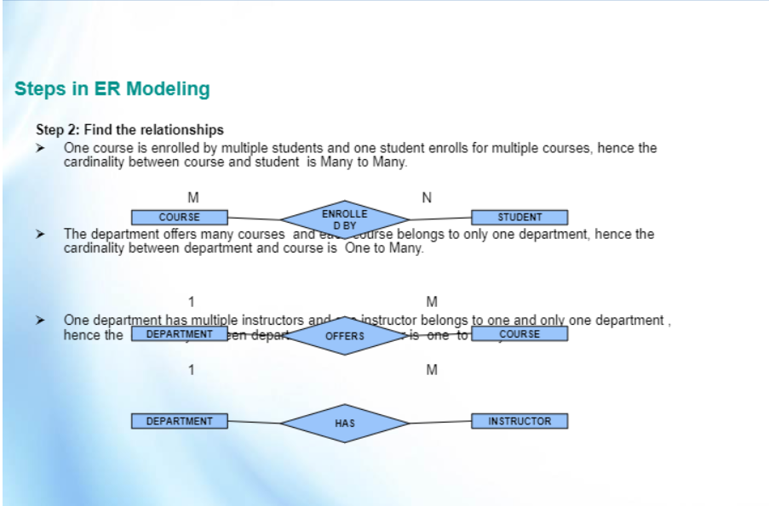

Slide 7
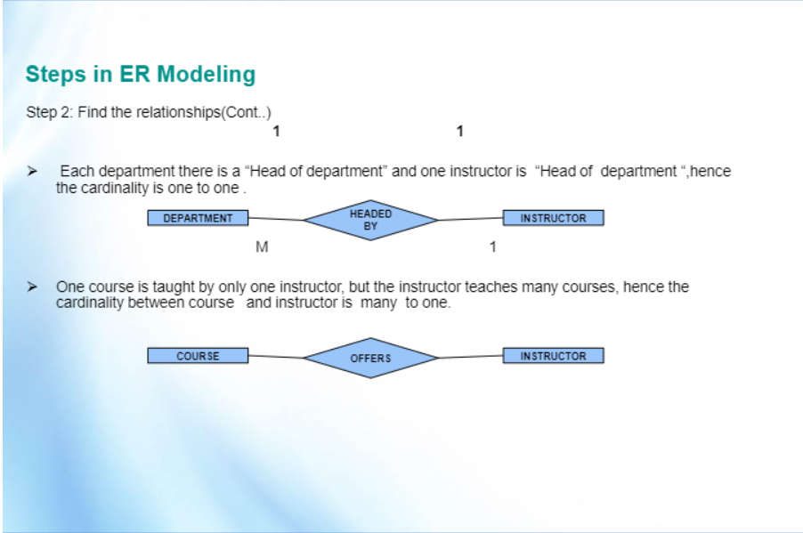

Slide 8
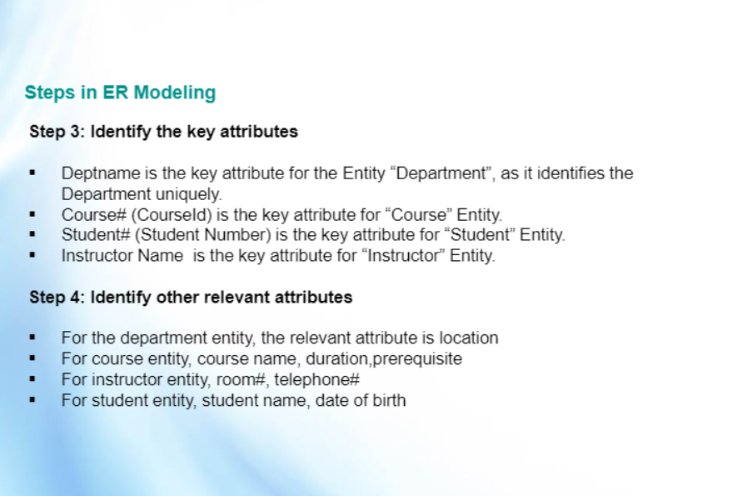

Slide 9
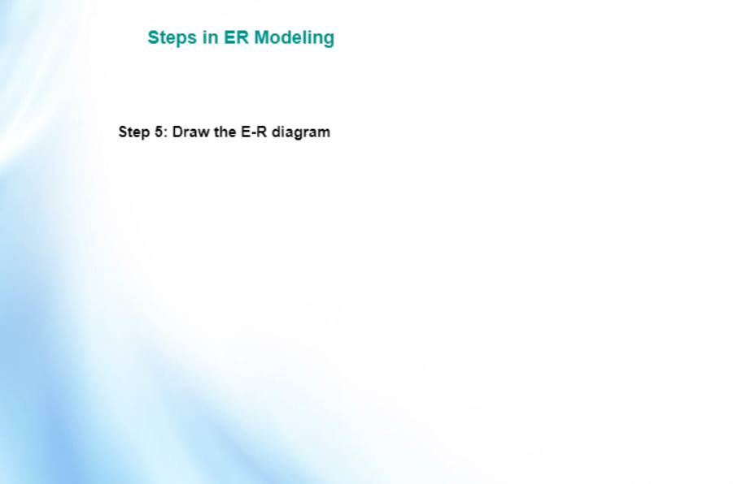

Slide 10
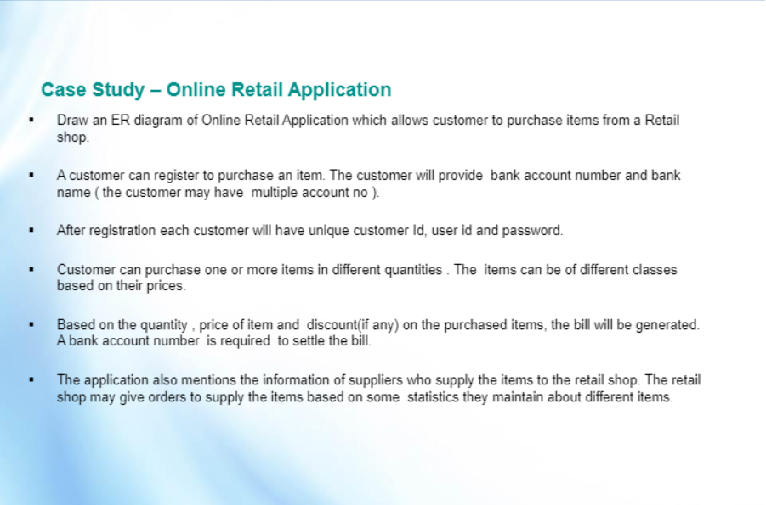

Slide 11
Identify the entities

Slide 12
Find the relationships

Slide 13
Identify attributes and primary keys

Slide 14
Create a ERD

